Slide 1
INNOVATION : Planning
Technology Management

Slide 2
Objective
Overview
The pros and cons of internal innovation
Product innovation and process innovation
The basic steps in the planning process for innovation
The technology stages and their possibilities for innovation
The development of a climate for internal innovation

Slide 3
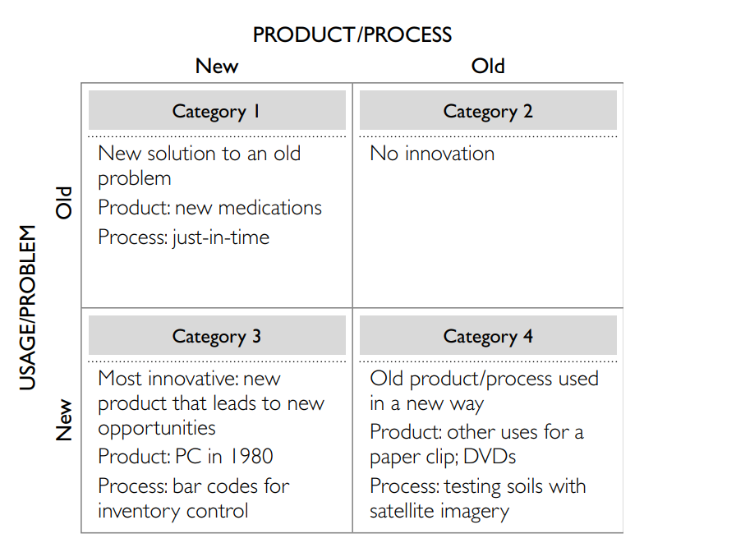
Innovation Categories

Slide 4
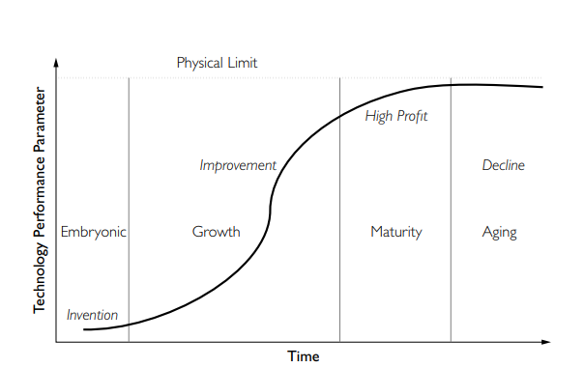
The S-curve of Technological

Slide 5
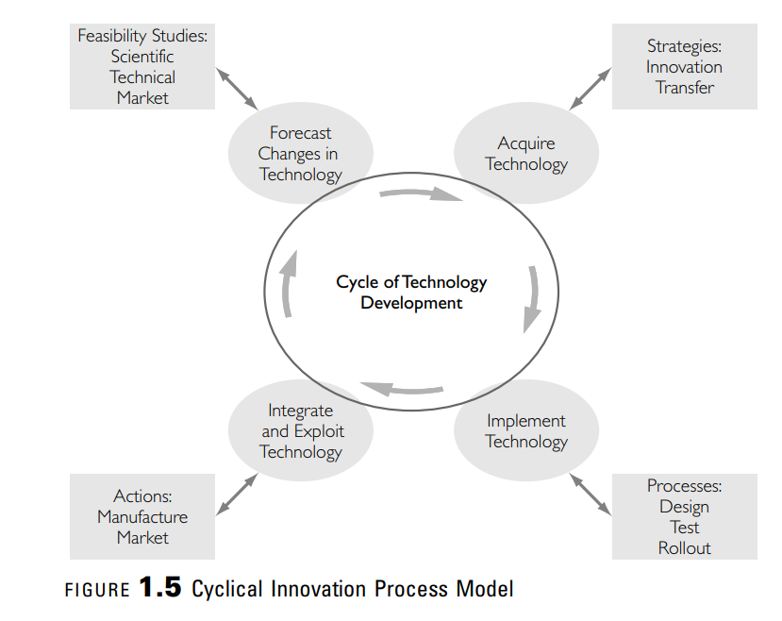
Cyclical Innovation Process Model

Slide 6
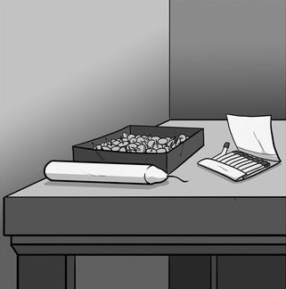
INNOVATE OR NOT TO INNOVATE

Slide 7
Factors that Favor Innovation
1. Greater control of the process and the outcomes
2. Greater understanding of the technology produced and how to apply it
3. Greater ability to potentially develop the next generation of technology
4. Greater profit potential as a first mover

Slide 8
Factors that discourage innovation
1. The time required for an internal development strategy is greater. If a new product is purchased, it is almost immediately available to the firm. However, if it is developed internally, the process may take years to develop the new processes and to market the new product.
2. There is a greater risk of failure to develop the right product at the right time.
3. Keeping a pipeline of new products and/or processes is difficult at best. There is always the danger that another firm will enter the market first

Slide 9
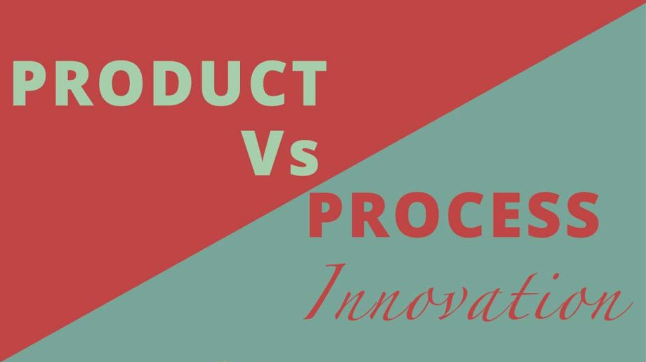
Types of Innovation

Slide 10
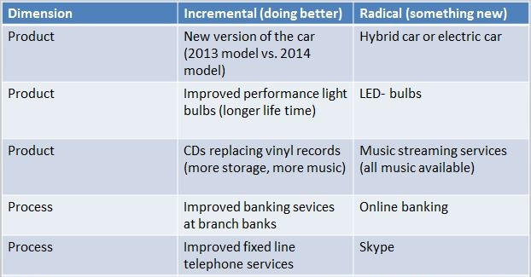
Incremental Vs Radical

Slide 11
Product Innovation
The types of innovation efforts found in the R&D process include:
1. Basic: Pure research and development
2. Applied: New product development
3. Systems integration: Product improvement or market expansion

Slide 12
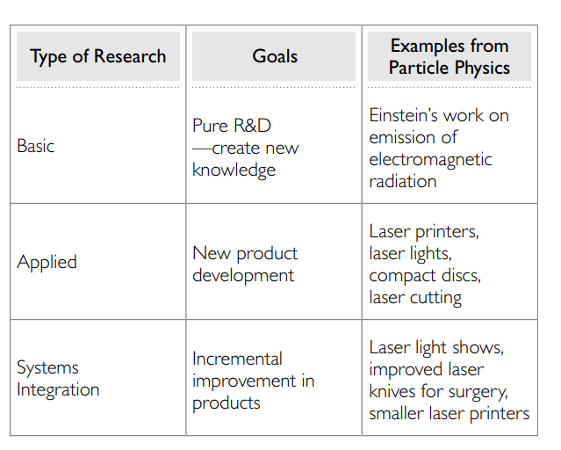

Slide 13
Process Innovation
Restructuring
Reorganization of a firm is often referred to as restructuring. It involves substantive changes in communication and coordination patterns within the organization.
Downsizing is a type of restructuring that occurs when a firm either sells some of its units or lays off employees.

Slide 14
Process Innovation
Reengineering requires fundamental rethinking and radical redesign of work processes.
Relevant questions for Reengineering:
Why is work (your work) performed the way it is?
What value is added by this process?
How can this work be done better?

Slide 15
Factors that AID Innovation Planning
1. Creativity
2. Organization-wide issues
3. Political issues

Slide 16
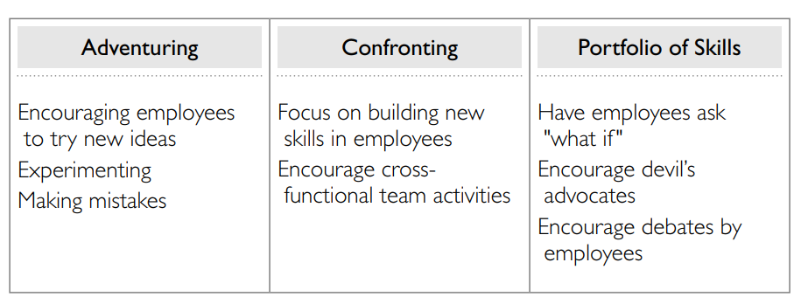
Factors that AID Innovation Planning
Creativity
Creativity requires more than simply creating new ideas. From a strategic standpoint, it is vital that individuals not only are creative but that the creative activity within the firm gets translated to the bottom line of the organization.

Slide 17
Creativity - Adventuring
Adventuring occurs when individuals explore areas that are outside their comfort zone and perhaps even that of the organization. Adventuring should have as its goal the generation of new ideas to deal with uncertainty.
Experimentation
Introspection (working from what is already known)
Scenario Making (thinking of various paths that innovations take)

Slide 18
Creativity - Confrontation
Confronting is a process that encourages deliberate debates among employees through such techniques as devil’s advocate or what if questioning. These debates can be conceptual or contextual.

Slide 19
Creativity – Portfolio of skills
Creative employees are encouraged to stretch beyond their normal boundaries into new domains. Thus, while confronting asks employees to enter into debates based on skills they already have, this method encourages creativity by asking employees to learn new skills.
Challenge can be resolve using cross-functional teams.
How to integrate the FYPs?

Slide 20
Organization-wide issues & Political Issues
1. Communication (Knowledge sharing)
2. Reward systems
3. Organizational assumptions(planned Reviews)

Slide 21
Innovation Planning Process
Determine the Vision and Mission
Establish Goals and Objectives
Tactics and Actions

Slide 22
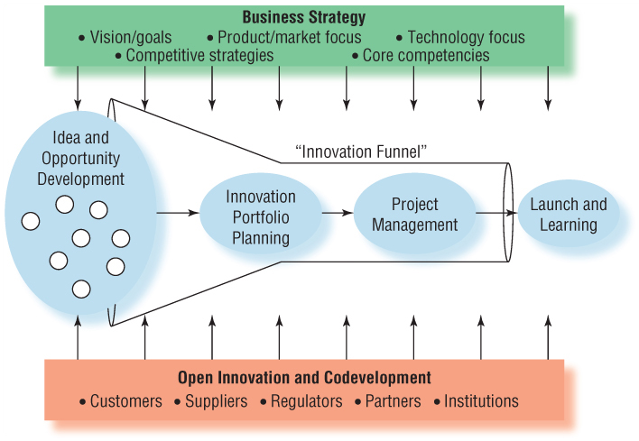
Innovation Strategy

Slide 23
Innovation Across the Product Life Cycle
Launch
Intense design and development
May need SC process innovation
Growth
Customer data aids in the refinement of product
Product changes, but moving toward standardization
Process innovation postponed
SC flexibility due to high mix/low volume, increasing capacity
Maturity
Demand stabilizes
Product stabilizes
Emphasis on cost
Process innovation needed to increase SC efficiency
Decline
Market/technology changes
Pressure to reduce cost and capacity
Incremental projects to extend life
Introduction of next generation products

Slide 24
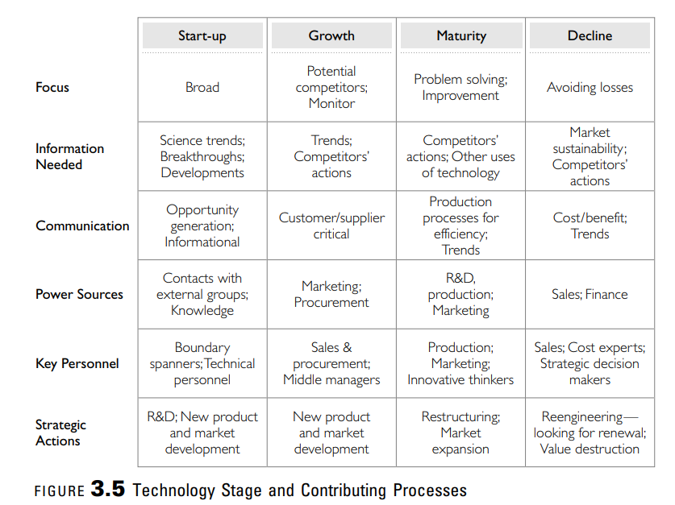

Slide 25
Innovation activity

